Slide 1
Jonathan Elisha & Ilya Gelfgat
Online Retail Dataset

Slide 2
About the dataset:
Analyze a comprehensive dataset of customer transactions.
Objective: to gain valuable insights and propose strategies for enhancing customer satisfaction, optimizing the sales process, and maximizing customer value.
Link for the dataset: https://archive.ics.uci.edu/dataset/352/online+retail

Slide 3

Issues with the Dataset
Rows
Duplicate rows
delete it or keep them
Kept: duplicates in the dataset
Deleted 135,000 rows because of null Customer ID's
Unclear dataset: negative values in the dataset
Invoice number and Stock Code with letters

Slide 4

Data Preprocessing and Data Cleaning
Handled missing values
Checked for null values

Slide 5
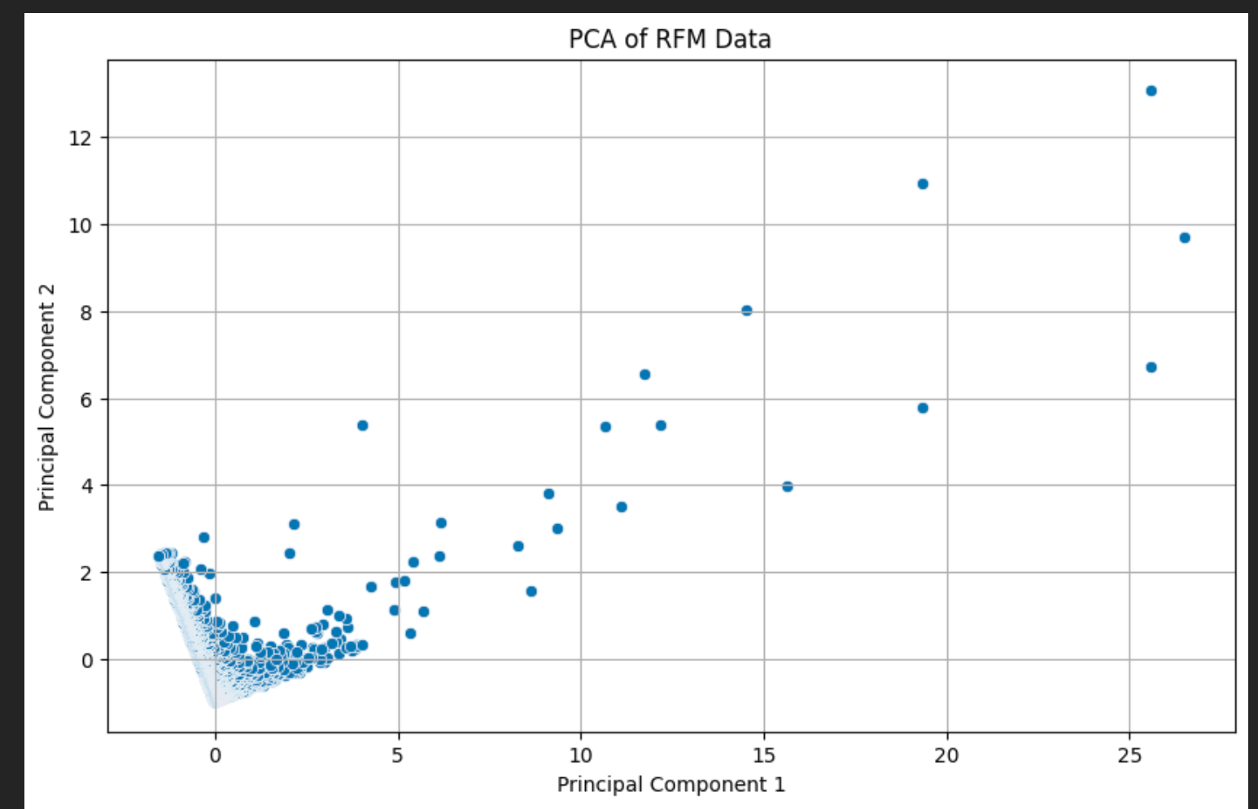
Customer Segmentation
PCA Analysis calculating RFM:
Recency
Frequency
Monetary
Cluster of Customers with the same habits and shopping patterns

Slide 6
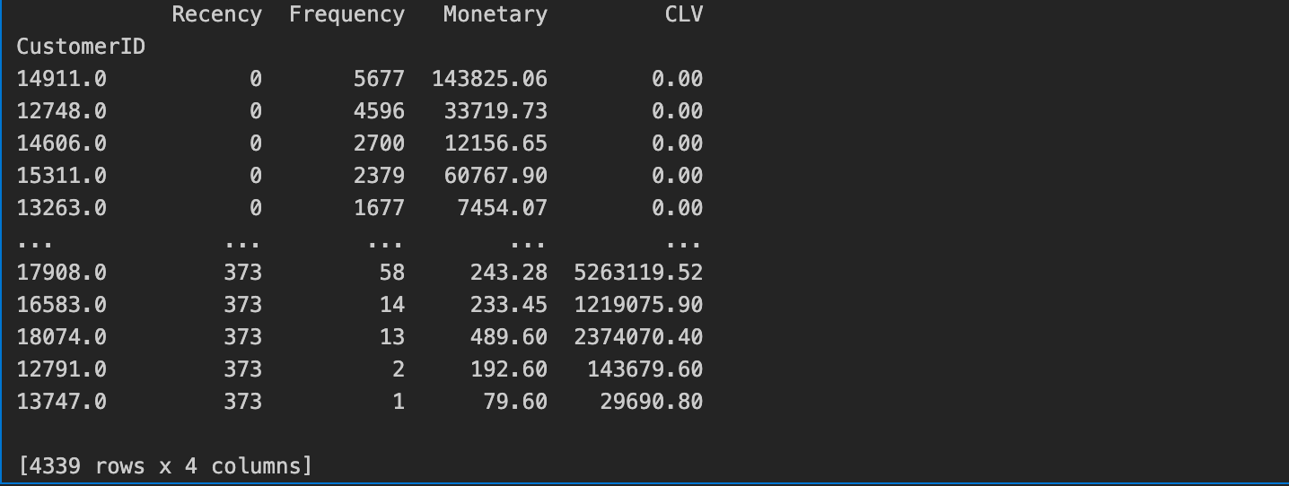
Calculation of the Customer Lifetime Value

Slide 7
PRODUCT ANALYSIS

Slide 8
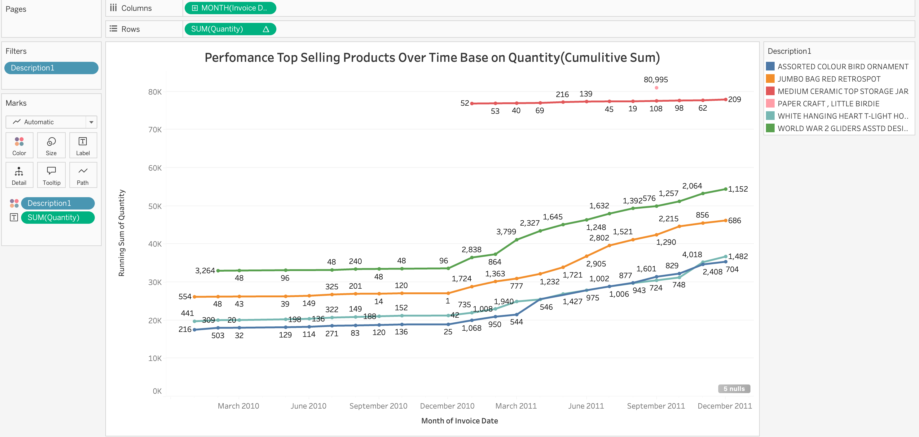

Slide 9
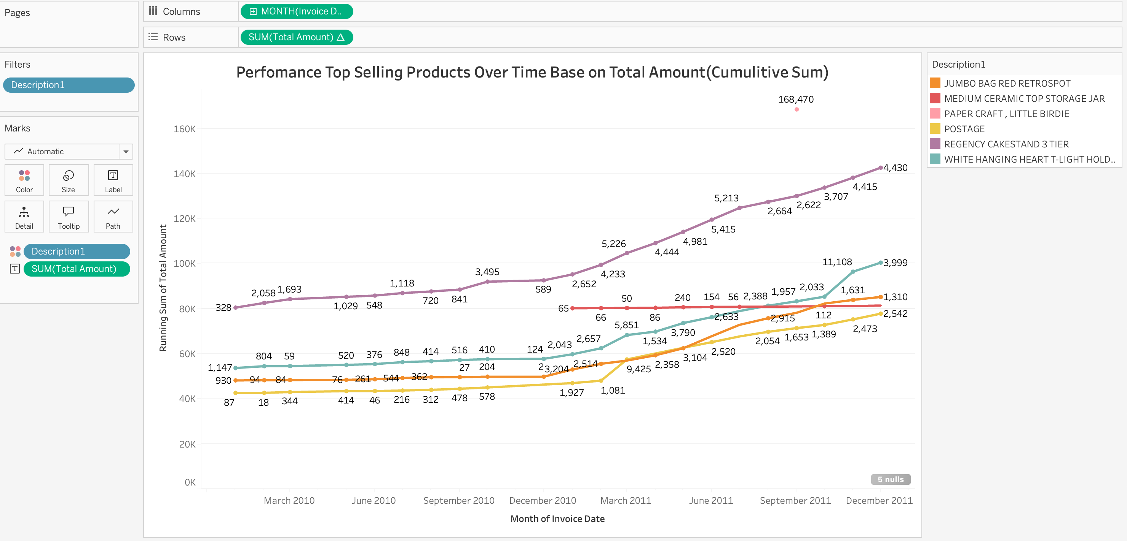

Slide 10
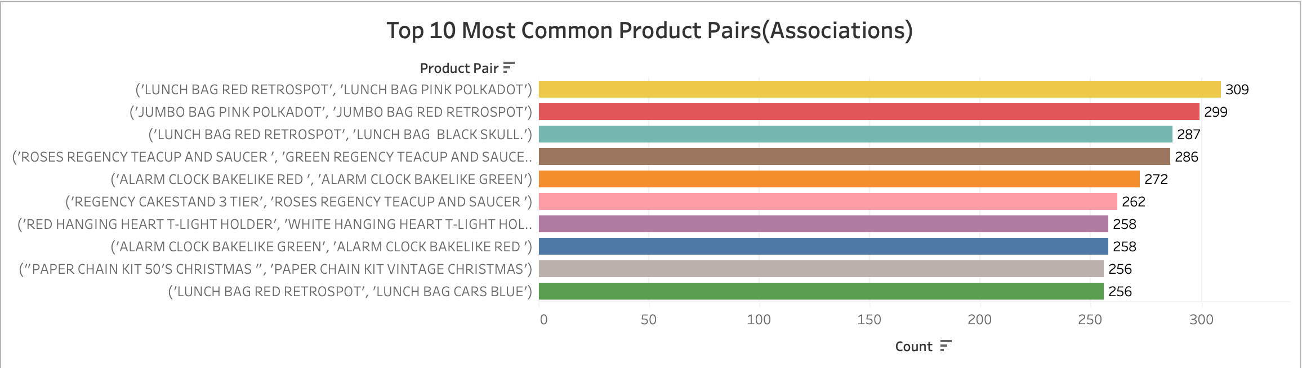

Slide 11
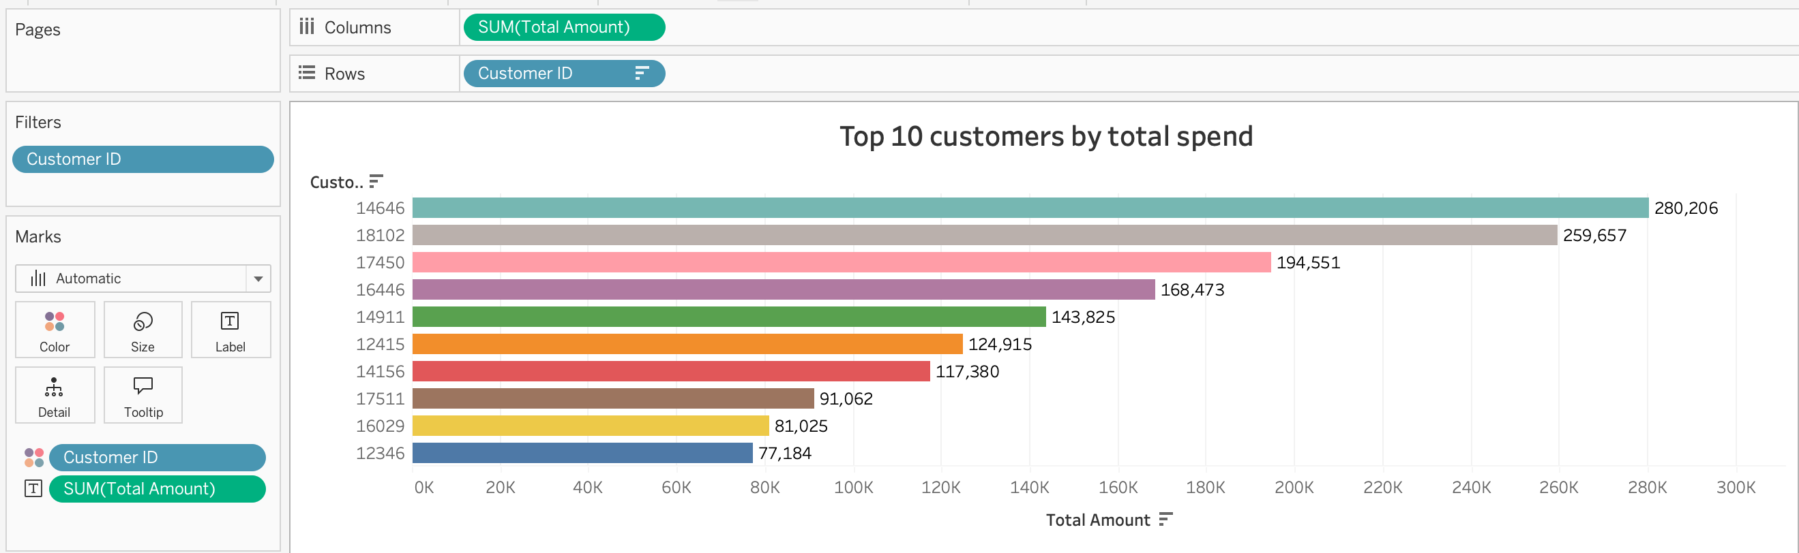

Slide 12
Key Takeaways
Most profitable product: Regency Cake Stand
Top paying Customer: Customer_ID 14646
Clear seasonal trend when people would buy the products
Companies can utilize product pair associations to create special deals for current and future customers
For future studies: Explore clustering for further analysis, examining correlation between age, gender and shopping habits. Exploring clustering, and examine which countries bought the most.

